Slide 1
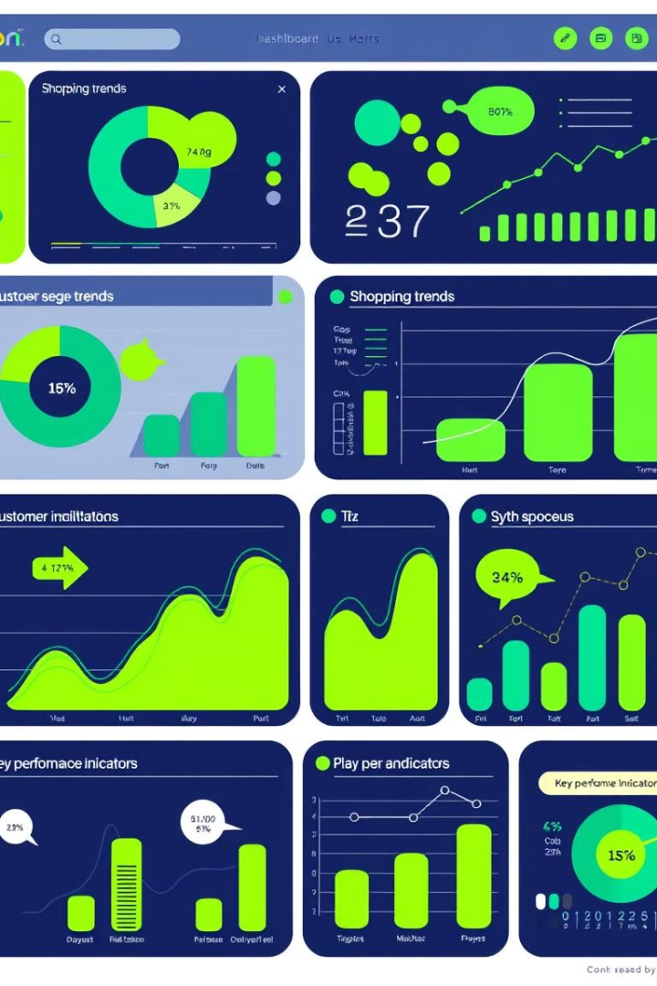
Customer Segmentation Analysis using Power BI
This presentation explores the use of Power BI to analyze customer shopping trends and identify distinct customer segments based on purchasing behavior, demographics, and preferences. The goal of this analysis is to provide insights for businesses to tailor their marketing strategies, improve customer engagement, and optimize resource allocation.

Slide 2
By:
Team-3
Gonna Rohan Sai
Lavanya Arigela

Slide 3
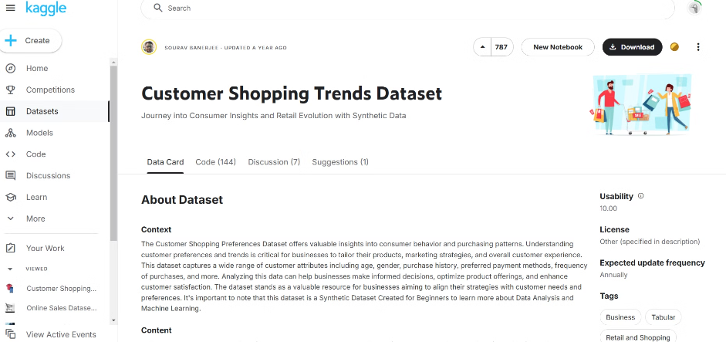
Data Source and Overview
Dataset: Kaggle
Scope of Analysis
This analysis utilizes a customer shopping trends dataset sourced from Kaggle, providing insights into various aspects of customer behavior and preferences.
The dataset includes information on customer demographics, purchase history, product categories, order values, and other relevant metrics, enabling a comprehensive analysis of customer segmentation.

Slide 4

Problem Statement
Identify Customer Segments
Optimize Marketing Efforts
The objective is to identify distinct customer segments based on their unique characteristics and purchase behaviors. This allows for targeted marketing and improved customer experiences.
By understanding customer segments, businesses can tailor their marketing strategies to resonate with each group, maximizing reach and impact. For instance, a "loyal customer" segment might receive personalized offers, while a "new customer" segment could benefit from introductory discounts.
Enhance Resource Allocation
Data-driven insights from customer segmentation can guide resource allocation, ensuring that marketing budgets and efforts are directed towards the most valuable customer segments.

Slide 5

Data Preprocessing
1
Data Cleaning
2
Data Transformation
This involves addressing missing values, handling duplicates, and correcting data inconsistencies to ensure data quality and reliability.
Transformations involve restructuring data by splitting columns, merging tables, and creating new calculated fields for analysis.
3
Data Type Corrections
4
Calculated Columns and Measures
Data types should be consistent with the data they represent (e.g., dates as Date, numbers as Decimal). This ensures accurate calculations and analysis.
DAX (Data Analysis Expressions) is used to create calculated columns and measures for advanced analysis and visualization.

Slide 6
DAX Measures and Calculations
DAX Measures
Total Sales:
Total Sales = SUM(Sales[Amount])
Total Profit:
Total Profit = SUM(Sales[Profit])
Average Price per Unit:
Avg Price per Unit = AVERAGE(Sales[PricePerUnit])
Yearly Profit:
Profit by Year = CALCULATE(SUM(Sales[Profit]), Sales[Year])
Sales by Category:
Category Sales = CALCULATE(SUM(Sales[Amount]), Sales[Category])
Profit Margin:
Profit Margin = DIVIDE(SUM(Sales[Profit]), SUM(Sales[Amount]))
Units Sold by Region:
Units Sold by Region = CALCULATE(SUM(Sales[Units]), Sales[Region])
These DAX measures are essential for analyzing
sales performance, profitability, and identifying
4trends over time.

Slide 7

Data Transformations in Power BI
1
Power Query Editor
2
Data Relationships
Power Query Editor allows for advanced data manipulation, including filtering, merging, and aggregating data for analysis.
Relationships between tables are established to enable cross-table analysis and calculations, providing a holistic view of the data.
3
Column Calculations
4
Filters
New columns are created using DAX for derived metrics like Profit Margin, Average Sales per Customer, and Top 10 Products by Sales.
Filters are applied to focus on specific data subsets relevant to the analysis, allowing for focused insights and visualizations.

Slide 8
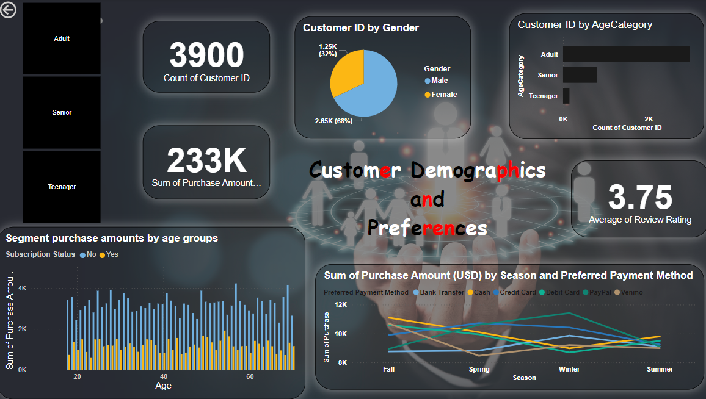

Slide 9




Customer Segmentation: Initial Insights
Total Customers
Total Revenue
Average Rating
3,900
$233,000
3.75
This initial overview provides a foundation for further segmentation analysis, highlighting key metrics related to the customer base and revenue.

Slide 10
Page 1: Customer Demographics and Preferences
Age Category
Gender Distribution
Subscription Status
Customers aged 40-60 years make the most purchases, indicating a potential target segment for marketing efforts.
Male customers represent a larger proportion of the overall customer base, suggesting potential differences in purchase behavior between genders.
Non-subscription customers dominate purchase amounts, especially in the 40-60 age group, highlighting the importance of this segment for generating revenue.

Slide 11
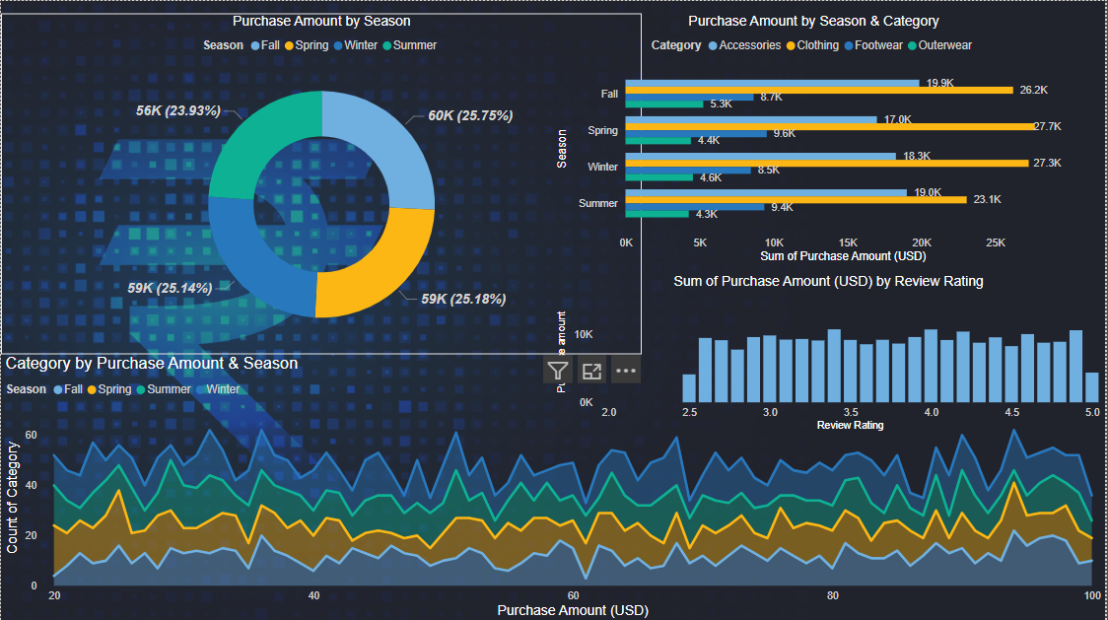

Slide 12




Page 2: Sales and Seasonal Trends
Clothing
1
Highest sales volume across all seasons, especially in Spring.
2
Accessories
Strong sales in Fall, suggesting potential seasonal marketing opportunities.
3
Footwear
Peak sales in Spring, indicating a seasonal trend for footwear purchases.
4
Outerwear
Elevated sales in Fall, aligned with seasonal demand for outerwear items.

Slide 13
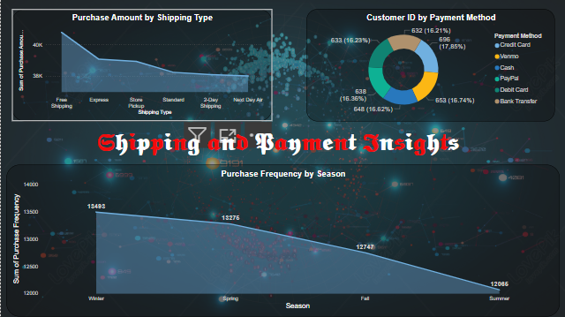

Slide 14
Page 3: Shipping and Payment Insights
Free Shipping
1
Dominates shipping preferences, suggesting a potential strategy to offer free shipping promotions for customer retention.
Credit Card
2
Most popular payment method, indicating a need for robust security measures and seamless online payment processing.
Seasonal Trends
3
Winter displays the highest purchase frequency, suggesting potential seasonal marketing strategies to capitalize on this trend.

Slide 15


